Slide 1
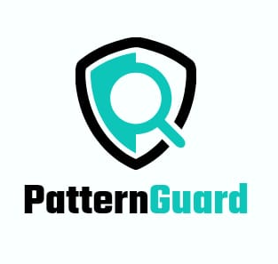
DARK PATTERN ANALYZER-
Pattern guard
Team Neural Nexus
Team members-
Aishi Chakraborty
Baivab Mukhopadhyay
Disha Karmakar
Souradip Pal
Ayush Dhua

Slide 2
What is Dark pattern?
A dark pattern refers to a user interface design that is crafted to manipulate or deceive users into taking actions that they might not otherwise choose to do willingly. Dark patterns are often employed on websites and in software interfaces to achieve specific goals, such as tricking users into signing up for services, making purchases, or providing personal information.
These patterns can take various forms, including misleading wording, hidden options, confusing interfaces, and pre-selected checkboxes. The intent behind dark patterns is generally to prioritize the interests of the website or service provider over the user's best interests, often resulting in a frustrating or deceptive user experience.
The term "dark pattern" is used to highlight the unethical or deceptive nature of these design practices. Many advocacy groups and individuals work to raise awareness about dark patterns and promote ethical user interface design.

Slide 3
Types of dark patterns
Dark patterns manifest in various forms, each employing deceptive techniques to manipulate user behavior. Here are some common types:
*Misdirection:* - Hidden Costs: Concealing additional fees until the last step of a transaction. - Sneak into Basket: Adding extra items to a user's cart without clear consent.
*Obstruction:* - Roadblocks: Introducing barriers that make it challenging for users to perform desired actions, such as canceling a subscription.
*Forced Action:* - Confirmshaming: Guilt-tripping users into taking certain actions by making alternatives seem socially unacceptable.
*Hidden Defaults:* - Pre-Selected Options: Automatically opting users into services or subscriptions unless they actively opt out.
*Interface Interference:* - Disguised Ads: Presenting advertisements that resemble native content, leading users to unintentionally click on them.

Slide 4
6. *Misleading Language:* - Trick Questions: Using ambiguous or confusing language to mislead users during decision-making.
7. *Urgency:* - Fake Scarcity: Creating a false sense of urgency by suggesting limited availability to prompt immediate action.
8. *Privacy Zuckering:* - Deceptive Privacy Settings: Manipulating users into sharing more personal information than they intend.
9. *Bait and Switch:* - Advertising One Thing, Delivering Another: Promising a certain product or service and delivering something less desirable.
10. *Friend Spam:* - Unauthorized Invitations: Automatically sending invitations or messages to a user's contacts without explicit consent.
Recognizing these dark pattern tactics is crucial for users to make informed decisions online. Advocacy for transparent and ethical design practices aims to discourage the use of such patterns and promote user-friendly interactions.

Slide 5
Our solution
To overcome the problems faced by users due to Dark patterns, we have proposed a solution which will be highly beneficial to the users.
Dataset used: Dark Patterns at Scale: Findings from a Crawl of 11K Shopping Websites* (Mathur et al.)
We will be marking/highlighting the most probable regions of dark patterns in the particular website by evaluating the html tags with the dataset and will be warning the users about the particular category of the dark pattern which is highlighted.

Slide 6
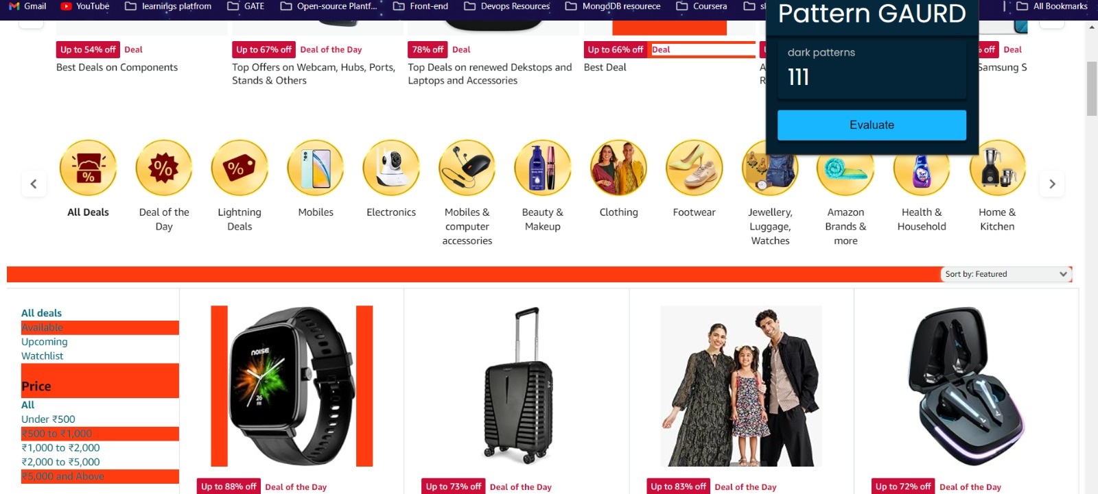

Slide 7
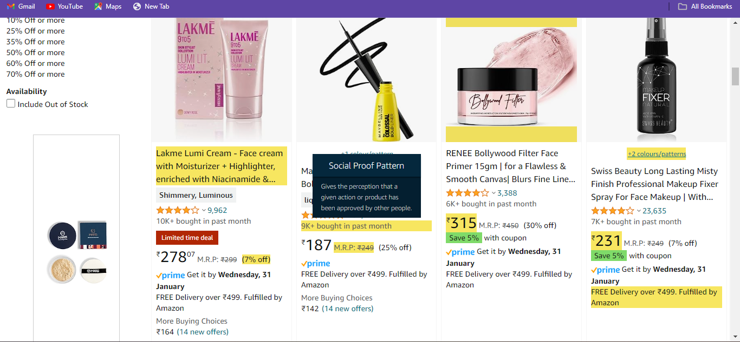

Slide 8
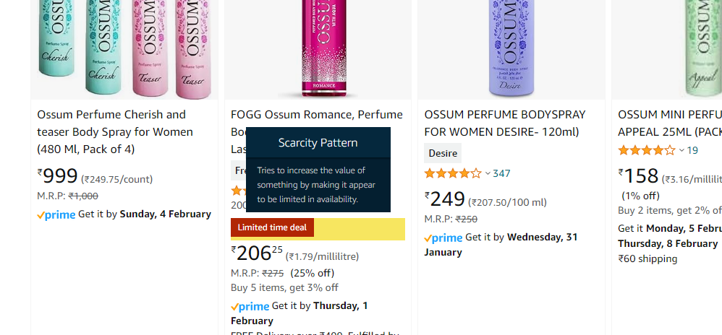

Slide 9
Technologies used
Flask:
Bullet Point: "Lightweight Web Framework"
Brief Description: "Flask provides a simple and modular framework for building web applications. It is widely used for creating RESTful APIs, emphasizing simplicity and flexibility."
Joblib:
Bullet Point: "Parallelization and Efficiency"
Brief Description: "Joblib is a Python library focused on parallelizing CPU-bound tasks. It enhances performance through parallel execution and memory-efficient data caching."
scikit-learn:
Bullet Point: "Comprehensive Machine Learning Library"
Brief Description: "scikit-learn is a powerful machine learning library offering a wide range of algorithms. It seamlessly integrates with scientific tools like NumPy, SciPy, and Matplotlib."

Slide 10
Steps to achieve our ideas 1)presence classification- To identify whether dark pattern is present or not 2) category classification- To identify the category of the dark pattern if present
Algorithms used:
Bernoulli Naïve Bayes
Multinomial Naïve Bayes

Slide 11
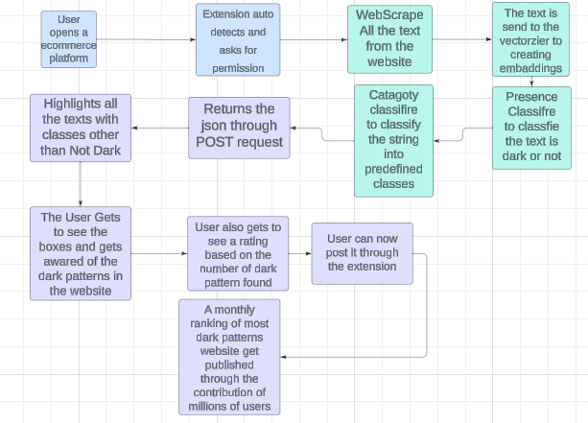

Slide 12
Business opportunities
1.Browser Extension Subscription Model:
- Offer a premium subscription model for the browser extension, providing advanced features and regular updates to users who are particularly concerned about online privacy.
2. API as a Service:
- Provide the dark pattern detection API as a service, allowing businesses to integrate the functionality into their own applications or websites.
3. White Labeling:
- Offer a white-label version of the tool that other businesses or organizations can rebrand and use as part of their services.
4. Collaboration with Browser Companies:
- Explore partnerships with major browser companies to integrate the tool as a built-in feature or extension, increasing its accessibility to a broader user base.
5. Crowdsourced Dark Pattern Database:
- Establish a platform where users can contribute and report new instances of dark patterns, creating a crowdsourced database that continuously improves the tool's accuracy.

Slide 13
Thank you

